Slide 1
Pros & Cons - Intruder Detection Methods
Methods | Pros | Cons
Line Crossing Detection | Mimic physical boundary virtually | Require a mean of detecting and tracking objects to determine whether a line was crossed Require the manual drawing of ”virtual” lines
Laplacian Threshold Detection | Leverage on readily available edges in video | Require the manual mapping of detection areas Unreliable detection when the edges of the intruder fail to cross the threshold
Background Subtraction | Not required to perform prior mapping of “virtual” lines or detection areas Responsive to changes in the environment Resistant to changes in lighting | Movement is displayed as coarse white silhouettes without further identifying features
Notes:
Line Crossing Detecting
Overview: (1) Detect object that appear in the video, (2) Track the movement of object, (3) Check if object has crossed “virtual” line.
Laplacian Threshold Detection
Overview: (1) Determine the areas to be detected, (2) Identify if the areas are vacant or occupied
Determine the areas to be detected
OpenCV: Perform a one-time mapping of target areas
(i) Canny edge detection: Get an edge image
(ii) Hough line transform: Draw out identified lines from the edge image
Identify of the areas are vacant or occupied
OpenCV: Check if the magnitude of the edges exceed the threshold

Slide 2
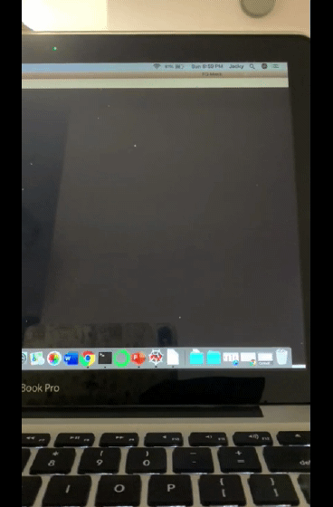
Detect Intruders by Background Subtraction
Implemented through OpenCV
Background Initialization
Background Update
Output of Background Subtraction
Notes:
Overview: Detect movement in webcam video through the Background Subtraction method. Any detected movement will be display in white against a black background.
Background Initialization – compute an initial model of the background
Generate the foreground mask using the cv::BackgroundSubtractor object
Read the video stream images sequence using the cv::VideoCapture
Background Update – update model in order to adapt to possible changes in the scene
Each frame currently calculate the foreground mask and updating the background
Results of the updated video stream is displayed
Model = Gaussian mixture model
Reference: Z.Zivkovic, Improved adaptive Gaussian mixture model for background subtraction, International Conference Pattern Recognition, UK, August, 2004, http://www.zoranz.net/Publications/zivkovic2004ICPR.pdf

Slide 3
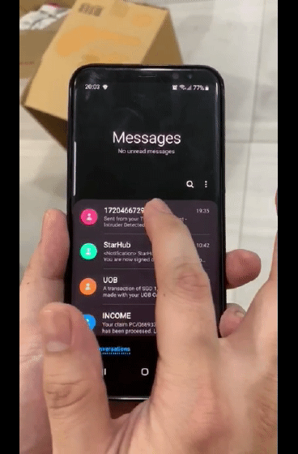
Intruders Alert Using Twilio
Intruder Identified by Face Recognition
Alert SMS Issued
SMS Alert of Intruder
Notes:
Twilio
Communication API for SMS
It works in the background to bridge the gap between web-based applications and telephones
Application-initiated event - initiated via Twilio's public REST API
In our case, our python script send an HTTP request to Twilio’s API to send a text message from the application's phone number to a recipient phone number, with a message containing the alert

